Slide 1
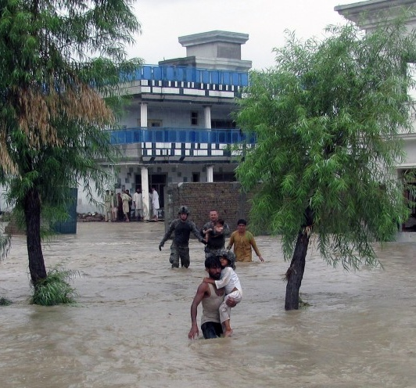
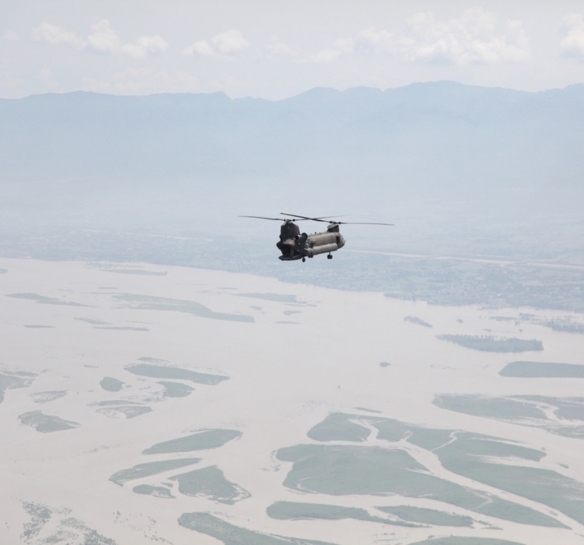
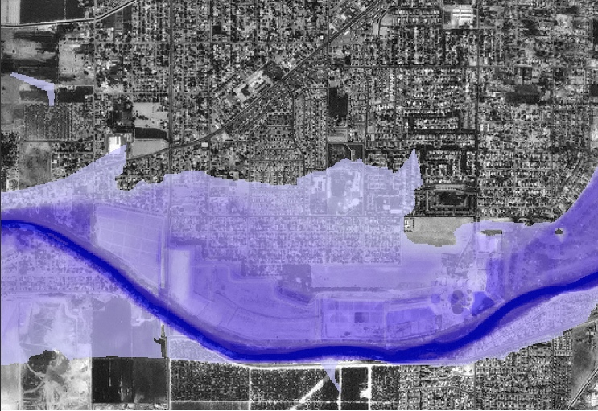
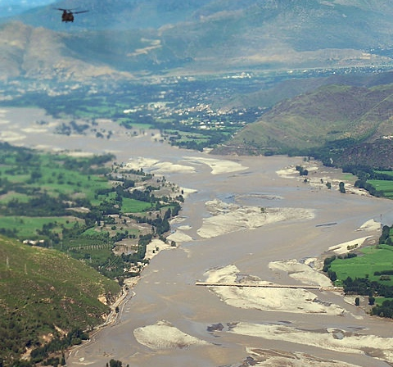
Global hydrometeorological modeling
REMOTE SENSING & Hydroclimate Modeling SUPPORT For Large Scale Watersheds
Sample photo
John Eylander, Lauren Cutler (USACE ERDC)
John Bolten, Sujay Kumar, Jim Geiger (NAS)
Distribution Statement A: Approved for public release, distribution is unlimited.

Slide 2
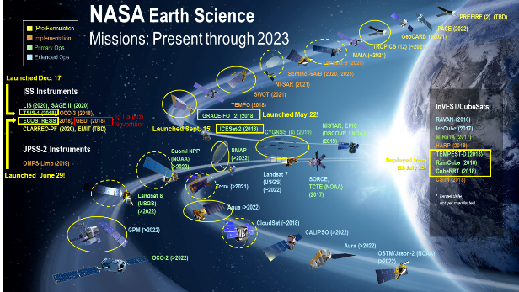
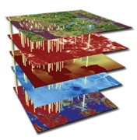
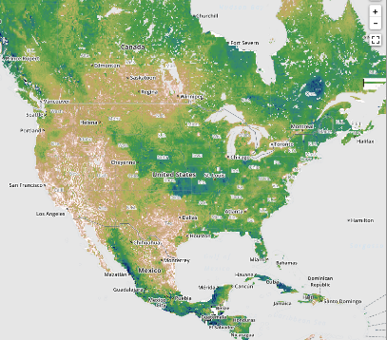
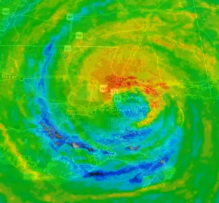
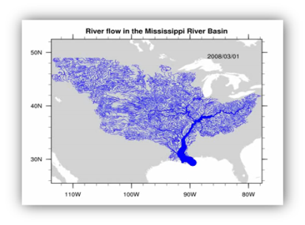
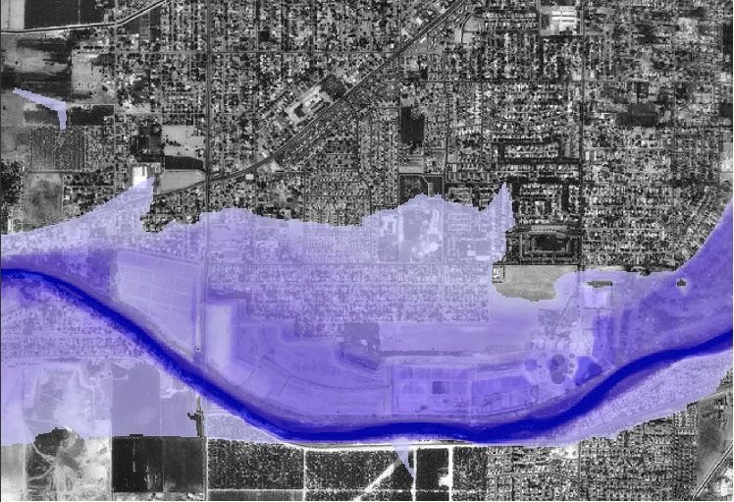
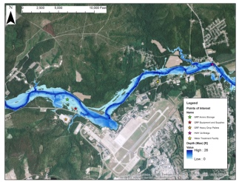
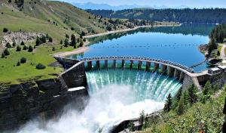
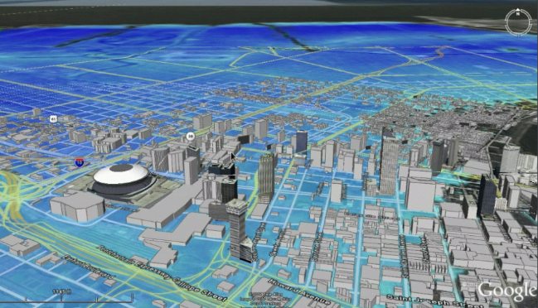
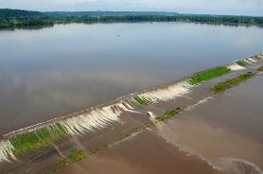

Total watershed assessment and forecasting
Multi-Agency Partnership for Hydroclimate Modeling
Terrain Data
Earth Observations
Earth System Modeling & Surface Water Characterization
Soil Moisture/Temperature
NASA: Satellites & remote sensing, Earth system modeling and climate res. & development (R&D)
USACE: Civil and military centers for hydrology/hydraulic modeling, water resources management, global reachback operations, research and development of water management, water system infrastructure, hydroclimate modeling
Payoff:
Interagency alignment to facilitate accurate global fine scale hydrologic/hydraulic predictions
Deliver authoritative products for decision making
improve the data-to-decision workflow
  Disaster response
  Water resources management
  Environmental security (sustainability/resilience)
Snow / Snow Water
Regional/Global Weather
Water Routing
Surface & Groundwater Observing/Modeling
Water Stress
Inundation mapping
Water Storage Changes
Impacts & Decision Support
UNCLASSIFIED

Slide 3
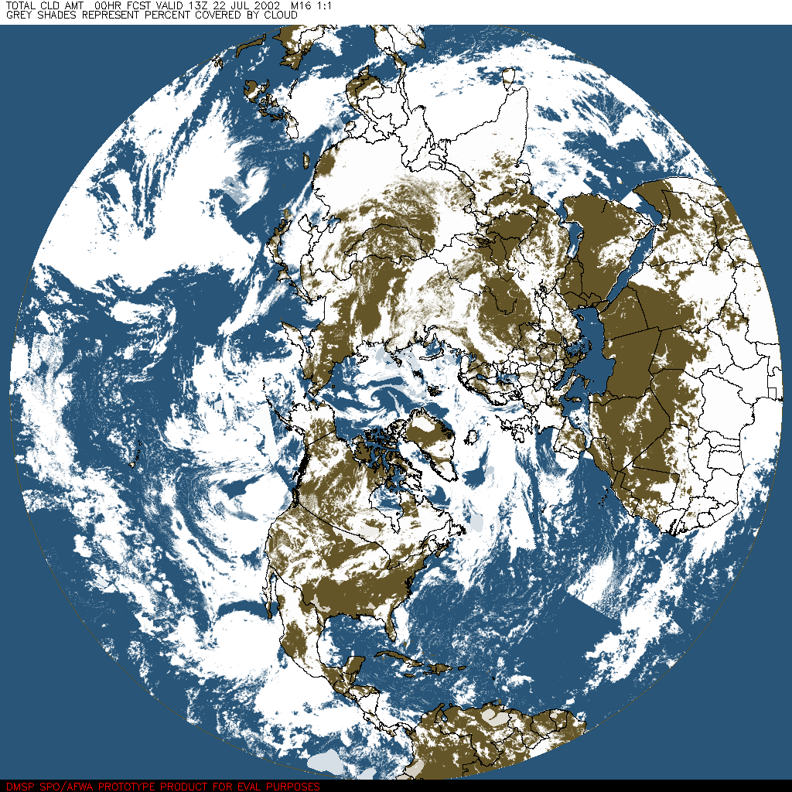
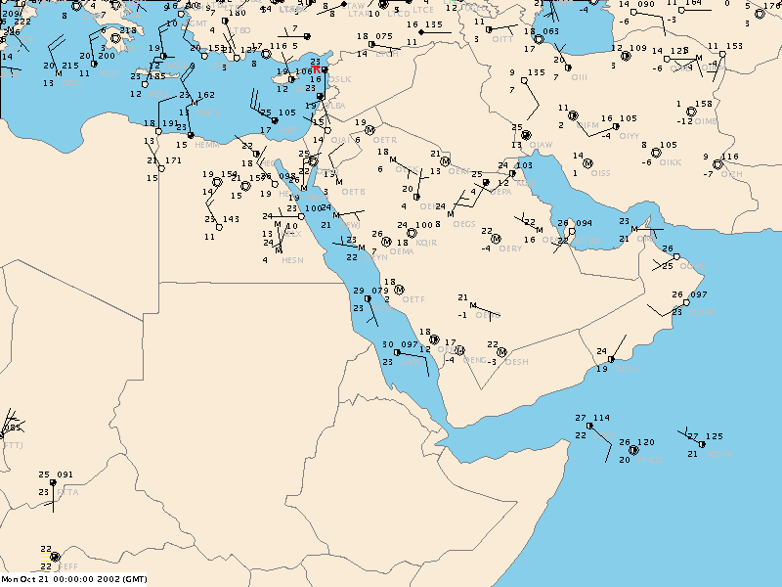
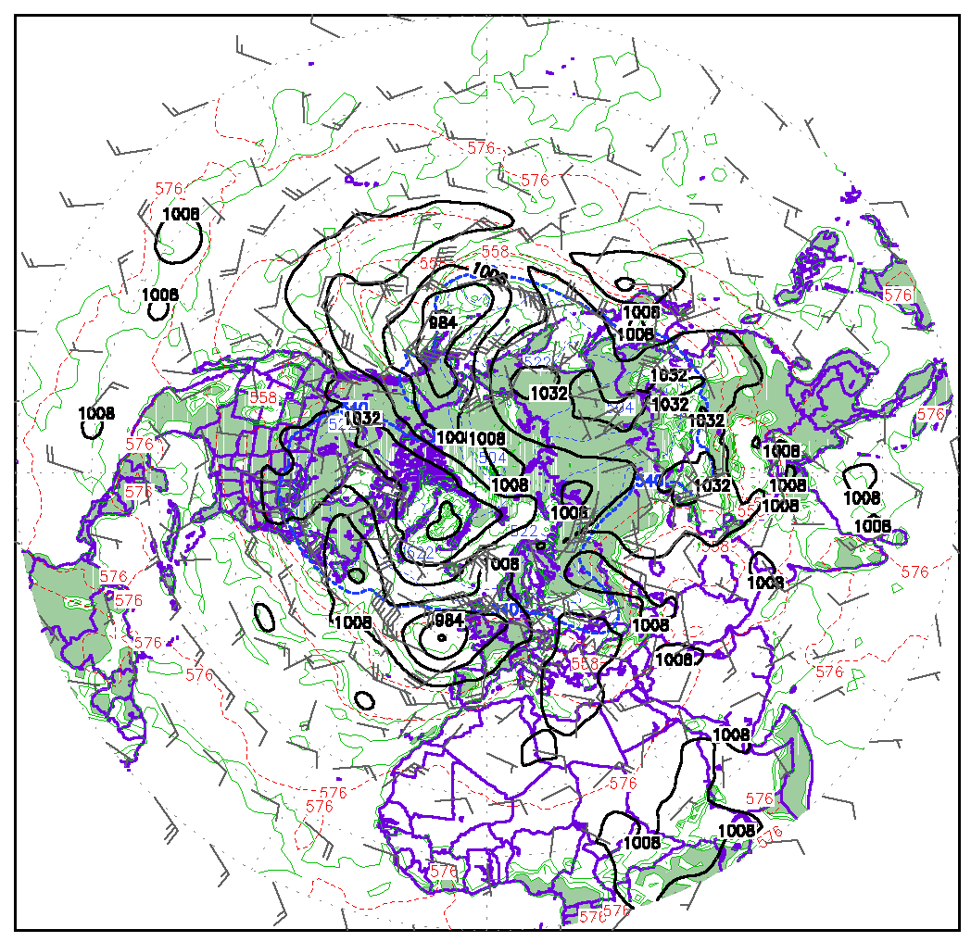
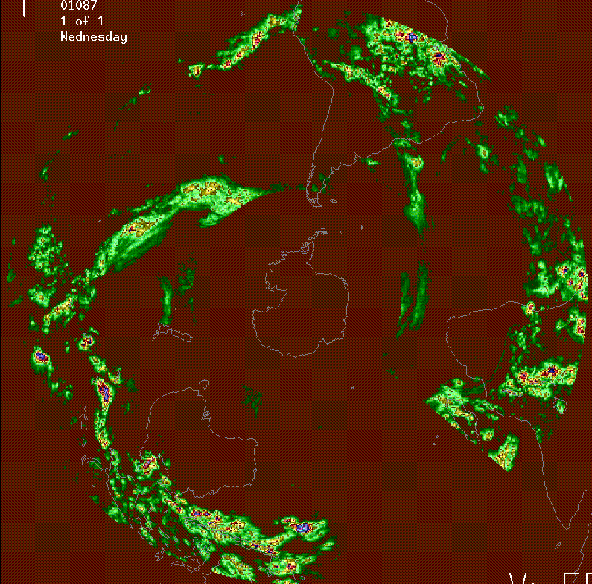
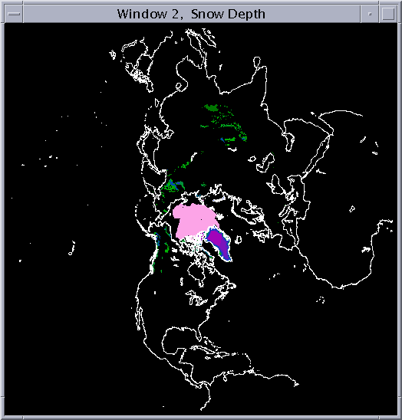
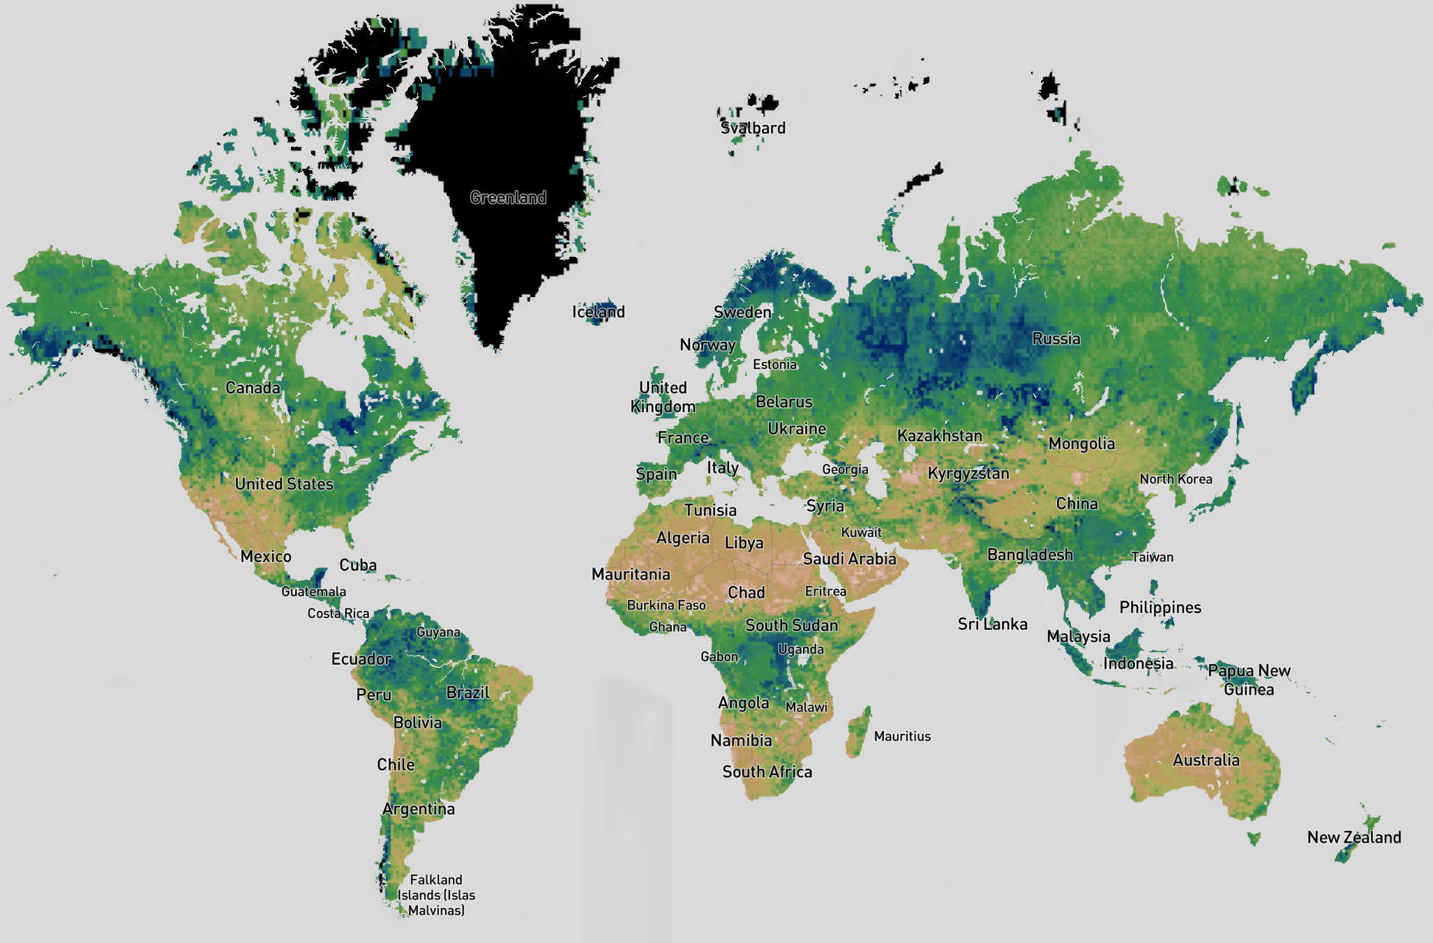

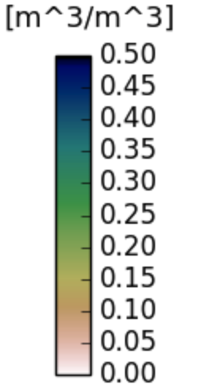

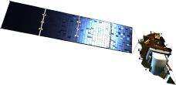
Land Information System (LIS) Overview
①
NWP first guess combined
with obs of T, u, v, RH
to derive shelter analysis
Land Data Assimilation System (LDAS) merges data from multiple sources to compute soil water mass and energy estimates useful for weather and climate forecasting, military applications
Global Cloud Cover Analysis
precipitation & snow observations & analyses
Weather (T, RH, Winds)
Satellite observations of soil moisture, temperature
Land surface model
Surface gauge & satellite,
(GEO & LEO) merged to
derive precip, snow analysis
②
Shelter Analysis
Radiation
Analysis
USAF global
cloud analysis
used to derive
surface radiation analysis
③
Precipitation
Analysis
Results
Satellite Soil
Moisture,
Temp. & Snow
4
5
Eylander et al. (2022)

Slide 4
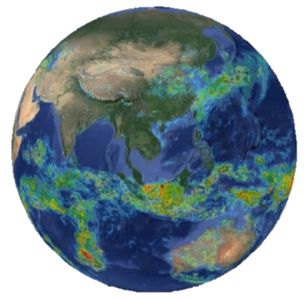
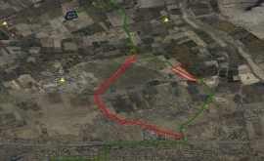
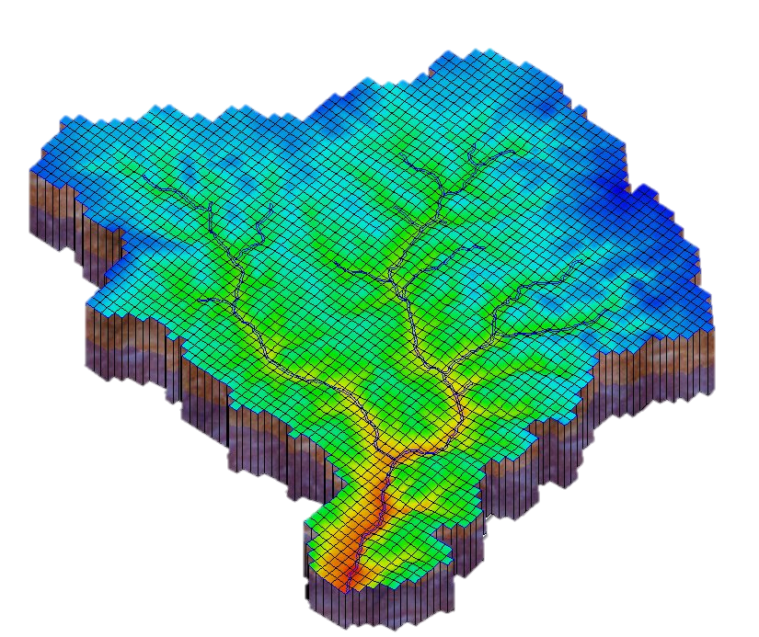
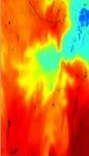
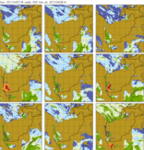
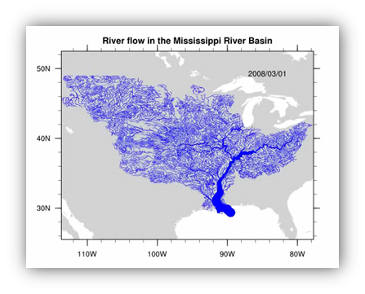
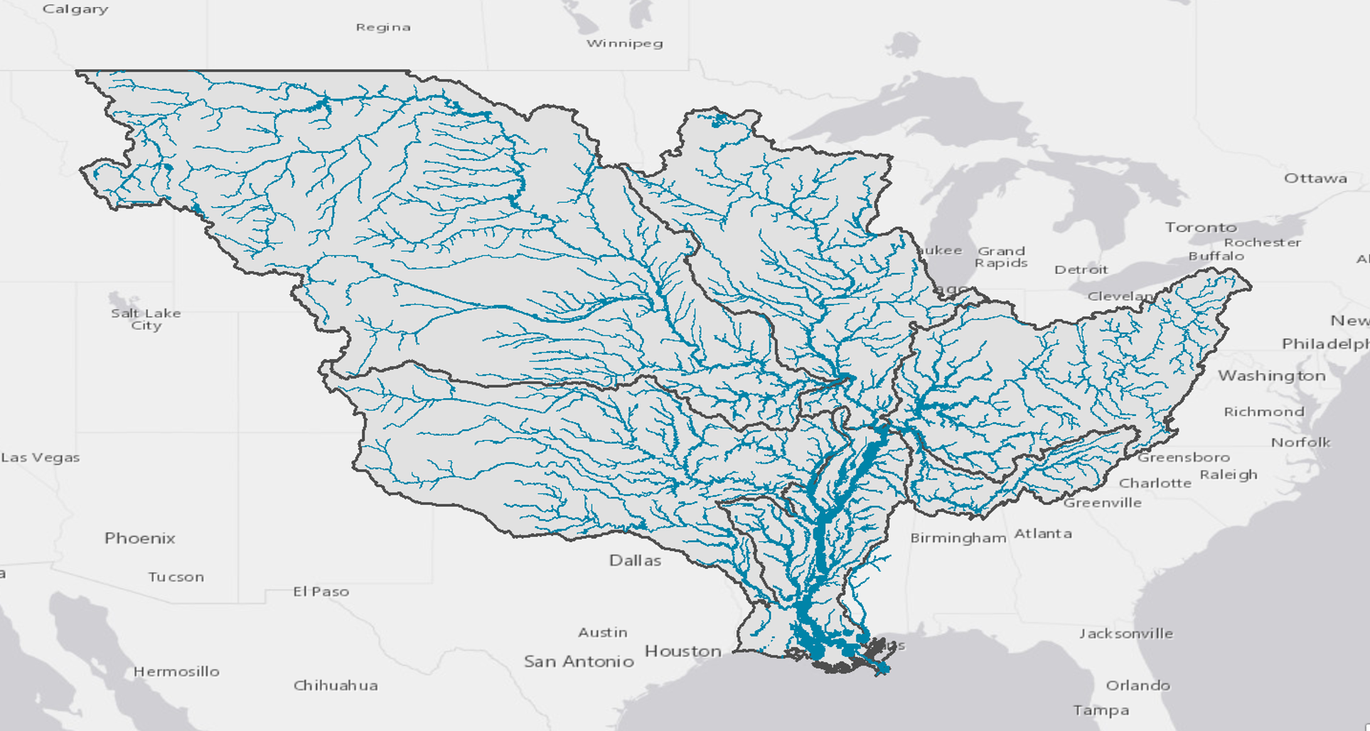
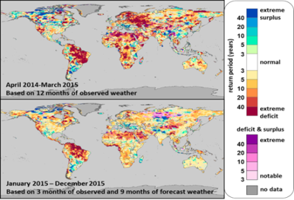
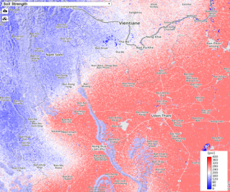

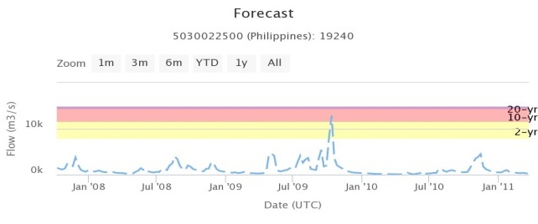
Coupled Hydroclimate Modeling Framework:-- Satellite-Informed Results
Weather/Climate Systems
Precipitation
Temperature
Humidity
Pressure
Wind Speed
Cloud Cover
Physical Geography
Terrestrial Modeling
Soil
Geology
Land Cover
Terrain
Hydrography
Hydraulic Routing
Runoff
Potential ET
Soil Moisture
Snow Water Equiv.
flow
(e.g. LIS LDAS)
Inundation Mapping
Spatiotemporal Products
(e.g. HyMAP, RAPID)
Water Security Indices
Soil Strength
Flood Extents
Streamflow

Slide 5
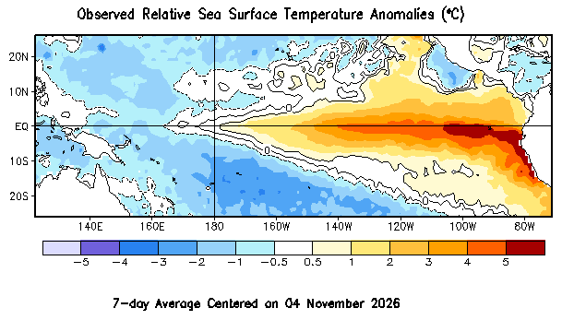
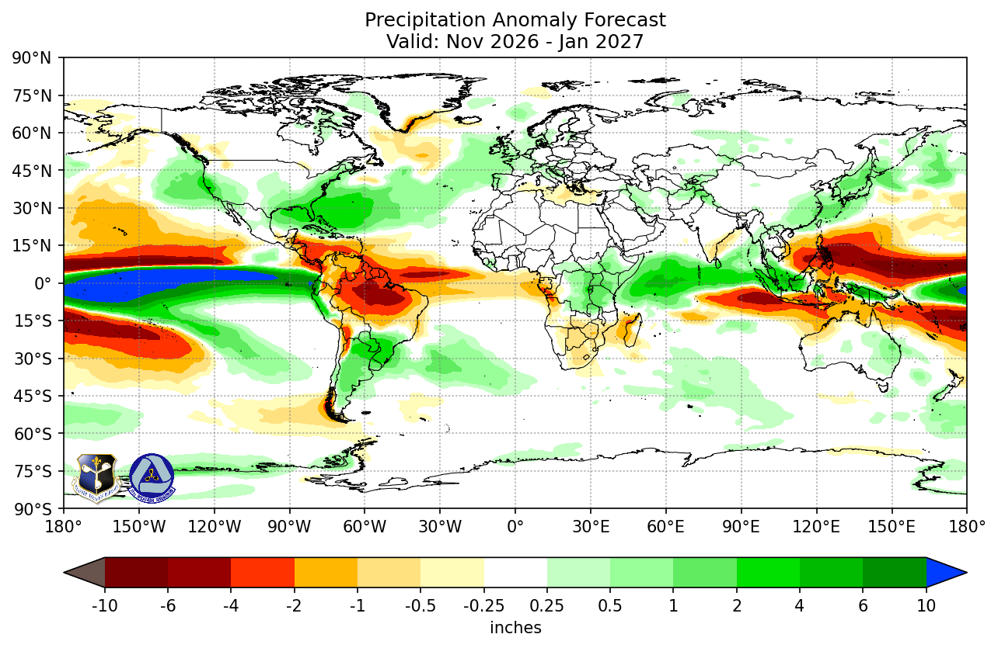
coupled Hydroclimate modeling benefits
Benefits:
Coupled hydroclimate &
hydrometeorology models enable:
  Large-scale hydrological predictions covering transboundary and/or continental basins
  Fully-initialized land states (e.g. soil moisture, surface water storage)
    Cycle land modeling systems over years and/or decades
  Land-atmosphere feedback improves the weather & seasonal forecast accuracy
  Able to see the impacts of climate signatures
    More directly evaluate impacts of ENSO on the analysis and forecast
  Enables ensemble-based analyses & forecasts to evaluate model uncertainty and risk
Challenges:
Computing requirements
  Parallel computing, large memory systems
Data storage - models are “big data” challenges
Network data feeds should be large enough to pull in weather data, satellite observations

Slide 6
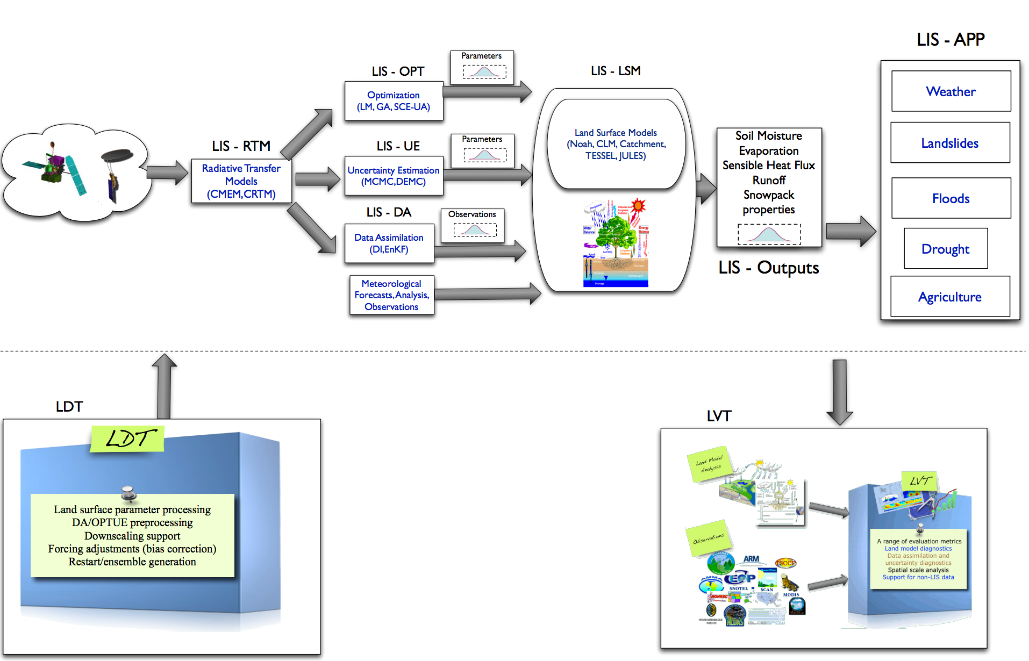
LIS v7.x Architecture Overview
LIS software consists of three configurable executables
Kumar, et al. (2008), Peters-Lidard et al. (2007)
Land Data Toolkit (LDT)
  Pre-process terrain datasets, observations, satellite observations
  prior to data assimilation
LIS components
  Radiative Transfer Models
  Data Assimilation
  Uncertainty Estimator, Parameter Optimization modules
  Land Surface Model
  LIS Post Processor
Land Verification Toolkit (LVT)
  Post-process LIS output
  Compare LIS runs with other
  land model output
  Compare LIS output to observations
  (ISMN soil moisture, stream gauge, etc)
Slide Courtesy
Sujay Kumar @ NASA
Arsenault, et al. (2018)
Kumar, et al. (2012)

Slide 7
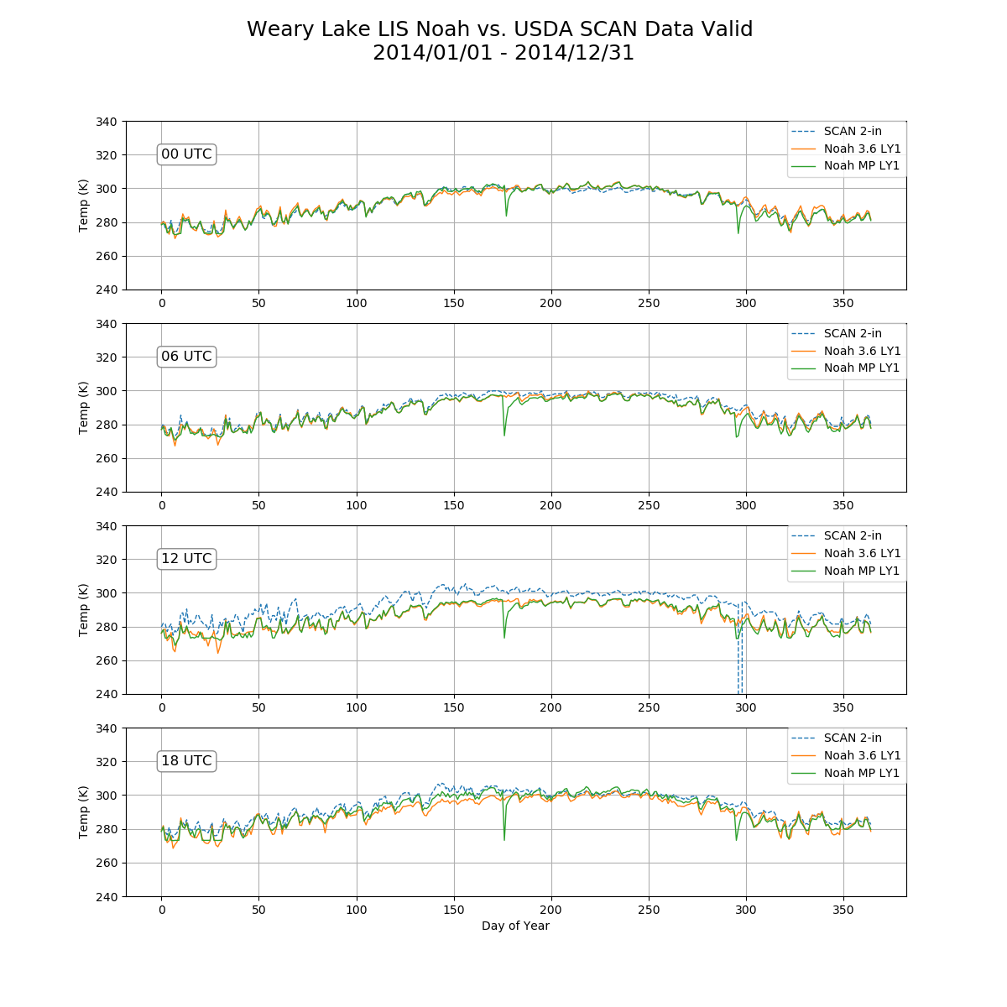
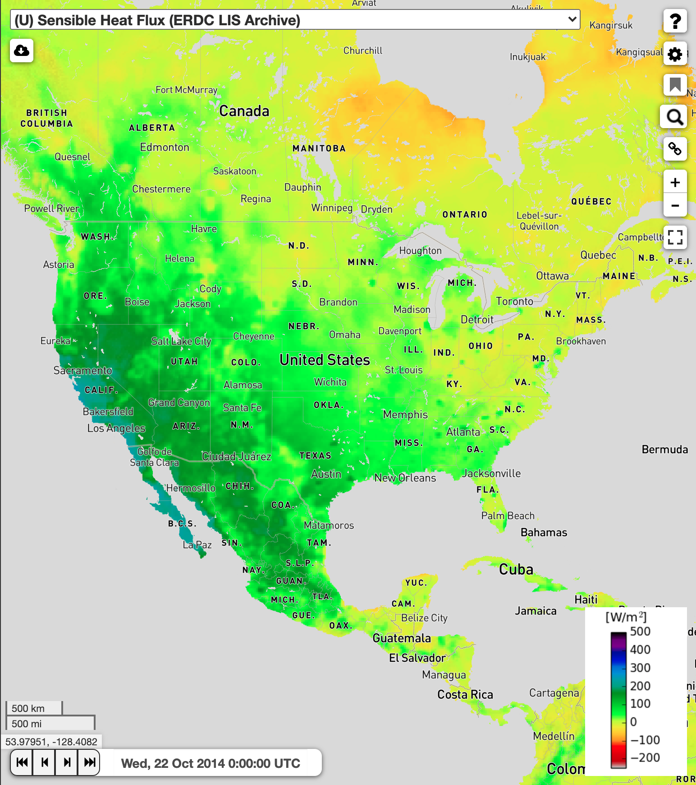
LIS runtime configuration “modes”
Retrospective (Historical) mode
  Useful for recomputing long-term analyses
  Supports seasonal, interannual analyses
  Executes from archived, pre-processed “forcings” – weather & terrain data used to drive LSMs
“AGRMET” mode
  Real-time running model
  Used to generate current analysis
  products
  NWP model initialization
  Executes from ”raw” input weather observations/gridded fields
  (cloud cover, precipitation, etc)
“GHI” Configuration
  Uses forecast model as input to LIS
  Compute forecast products
  Seasonal and subseasonal forecasts
Sensible Heat Flux
Noah 3.6 & Noah MP Soil temperature

Slide 8
Data Assimilation for Hydro-Terrestrial Modeling
LIS and LIS-GHI designed to take advantage of vast amounts of remotely sensed environmental observations available
USAF LIS development sponsored by DOD environmental satellite programs to enable greatly increased amount of satellite products used to create terrestrial analysis products (e.g. JPSS Sensors, NASA SMAP, ESA SMOS, etc)
Since LIS IOC at 557WW, added real-time snow water, snow cover, soil moisture, and vegetation stress assimilation into operational LIS
LIS ingests data from over a dozen satellites in real-time (including clouds, precipitation, land-use and vegetation products)

Slide 9
LIS Software Architecture, Data Standards
FORTRAN modular design
Parallel software execution design (MPI)
Able rapidly spin up a new model domain in less than 1-day
Earth System Modeling Framework (ESMF) data structures, time components
Configurable resolution, domain, physics and parameterizations (global and regional domains)
  Multiple LSM Options (including but not limited to…)
Generic implementation of EnKF/EKF/DI Data Assimilation structure
Supports climate studies, or retrospective analyses, and real-time operations
Data standards
  supports NetCDF, HDF, GriB, Input/Output, geospatial output formats (includes GeoTIFF, GDAL library links)
Multiple meteorological forcing options; multiple land parameter dataset options
Ensemble modeling capability (Ensemble DA, Parameter pertubations, multi-model)
Software maintained in NASA GitHub repository
NASA has released a majority of the LIS source code as “open source” (portions specific to USAF/DOD are restricted)
Noah (v3.6+) | NASA Catchment | US Army FASST | Mosaic
Noah Multi-Parameterization | VIC | CABLE (Australia) | HY-Ssib
NCAR Community Land Model | JULES (UK) | Snow-17 | GeoWRSI

Slide 10
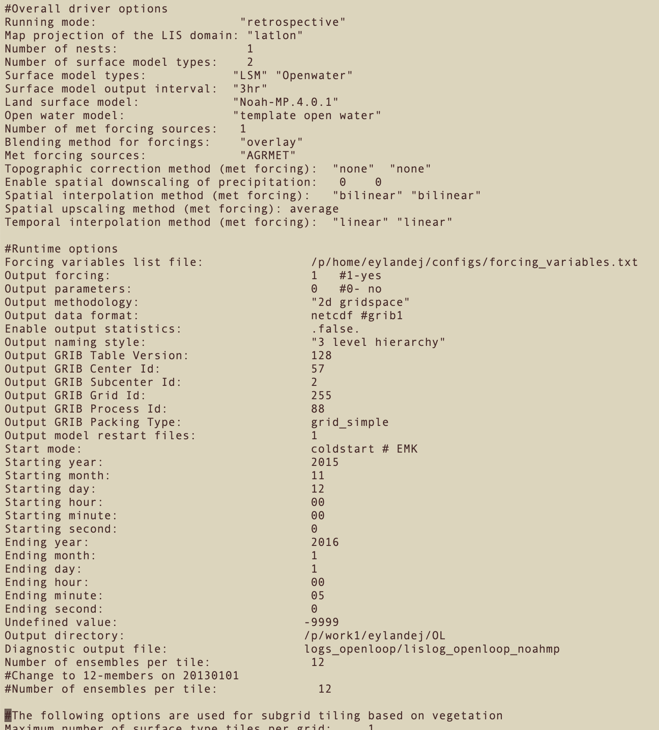


How to run LIS Software
Each LIS executable is controlled by a configuration file:
  Execution mode
  Type and configuration of LSM
  Terrain datasets (elevation, slope, soils, vegetation, etc)
  Start date and length of model run
  Assimilation configuration
  Primary meteorological forcings
  Primary and supplemental precipitation
  Supplemental climatology data
LIS operational runs execute on HPCs with parallel computing Message Passing Interface (MPI, OpenMPI), submitted via “batch” submission
Newer cloud-capable options (e.g. AWS) to execute LIS within a container
Can be compiled on a PC/MAC system (Gnu C/Fortran compilers)
DOD High Performance Computing Center Program (HPCMP)

Slide 11
Types of products using LIS infrastructure
Coupled Numerical Weather Forecasting
Surface Energy Fluxes (Latent, Sensible)
snow cover/depth, snow water content
Food and Agriculture Support
Soil moisture, soil temperature, precipitation analyses, snow cover, snow water
  Reference USDA crop explorer system (https://ipad.fas.usda.gov/cropexplorer/)
  NASA FLDAS system (https://ldas.gsfc.nasa.gov/fldas) – supports FEWS-NET (McNally et al., 2017)
Drought indices, drought forecasts (e.g. NASA Hydrological Forecast and Analysis System (NHyFAS; Arsenault et al., 2020)
Global Hydrological Support – runs operational at the USAF 557th Weather Wing
soil moisture
  linked to real-time Army ground vehicle mobility modeling capability; Eylander et al. 2023)
surface runoff and streamflow forecasting (Getirana et al. (2012))
USACE Reachback Operations Center (UROC) support – global flood and military operations support
Hydroclimate analysis (multi-year/multi-decade)
Seasonal/subseasonal forecast (GHI S2S system, papers in development)

Slide 12
References
Kumar, S.V., C.D. Peters-Lidard, Y. Tian, R.H. Reichle, J. Geiger, C. Alonge, J. Eylander, and P. Houser, 2008: An integrated hydrologic modeling and data assimilation framework enabled by the Land Information System (LIS). IEEE Computer, 41(12), 52-59, doi:10.1109/MC.2008.475
Kumar, S.V., R.H. Reichle, C.D. Peters-Lidard, R.D. Koster, X. Zhan, W.T. Crow, J.B. Eylander, and P. R. Houser, 2008: A Land Surface Data Assimilation Framework using the Land Information System: Description and Applications. Advances in Water Resources, 31, 1419-1432, doi:10.1016/j.advwatres.2008.01.013
Peters-Lidard, C.D., P.R. Houser, Y. Tian, S.V. Kumar, J. Geiger, S. Olden, L. Lighty, B. Doty, P. Dirmeyer, J. Adams, K. Mitchell, E.F. Wood and J. Sheffield, 2007: High-performance Earth system modeling with NASA/GSFC's Land Information System. Innovations in Systems and Software Engineering, 3(3), 157-165, doi:10.1007/s11334-007-0028-x
Reichle, R.H., S.V. Kumar, S.P.P. Mahanama, R.D. Koster, and Q. Liu, 2010: Assimilation of satellite-derived skin temperature observations into land surface models. J. Hydrometeor., doi:10.1175/2010JHM1262.1
Reichle, R. H., D. B. McLaughlin, and D. Entekhabi, 2002a: Hydrologic Data Assimilation with the Ensemble Kalman Filter. Mon. Weather Rev., https://doi.org/10.1175/1520-0493(2002)130<0103:hdawte>2.0.co;2.
Getirana, A. C. V., Boone A. , Yamazaki D. , Decharme B. , Papa F. , and Mognard N. , 2012: The Hydrological Modeling and Analysis Platform (HyMAP): Evaluation in the Amazon basin. J. Hydrometeor., 13, 1641–1665, doi:10.1175/JHM-D-12-021.1.
David, C. H., D. R. Maidment, G.-Y. Niu, Z.-L. Yang, F. Habets, and V. Eijkhout (2011), River network routing on the NHDPlus dataset, J. Hydrometeorol., 12(5), 913–934.
Arsenault, K.R., and Coauthors, 2020: The NASA hydrological forecast system for food and water security applications. Bull. Amer. Meteor. Soc., 101, E1007–E1025, https://doi.org/10.1175/BAMS-D-18-0264.1
Arsenault, K.R., S.V. Kumar, J.V. Geiger, S. Wang, E. Kemp, D.M. Mocko, H.K. Beaudoing, A. Getirana, M. Navari, B. Li, J. Jacob, J. Wegiel, and C.D. Peters-Lidard, 2018: The Land surface Data Toolkit (LDT v7.2) – a data fusion environment for land data assimilation systems. Geosci. Model Dev., 11, 3605-3621, doi:10.5194/gmd-11-3605-2018
McNally, A., Arsenault, K., Kumar, S. et al. A land data assimilation system for sub-Saharan Africa food and water security applications. Sci Data 4, 170012 (2017). https://doi.org/10.1038/sdata.2017.12
Eylander. J.B., S.V. Kumar, C.D. Peters-Lidard, T.A. Lewiston, C. Franks, J. Wegiel (2022): History and Development of the USAF Agriculture Meteorology Modeling System and resulting USAF-NASA Strategic Partnership, Weather Analysis and Forecasting, 37, 2293-2312, DOI: 10.1175/WAF-D-22-0064.1,

